Slide 1
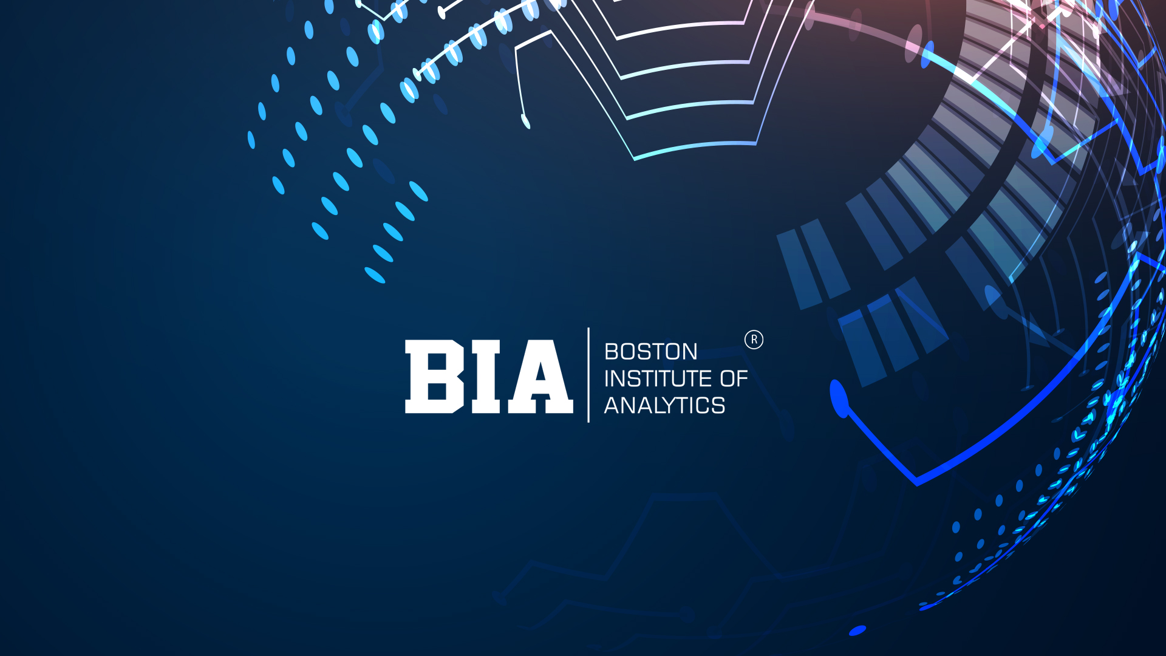

Slide 2
CUSTOMER SEGMENTATION ANALYSIS
PRESANTED BY
REENA PRAJAPATI

Slide 3
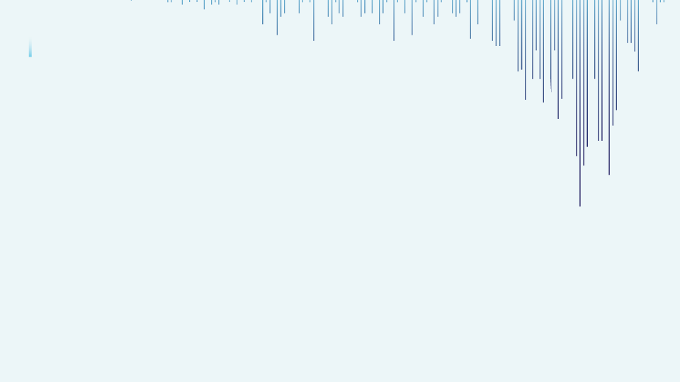

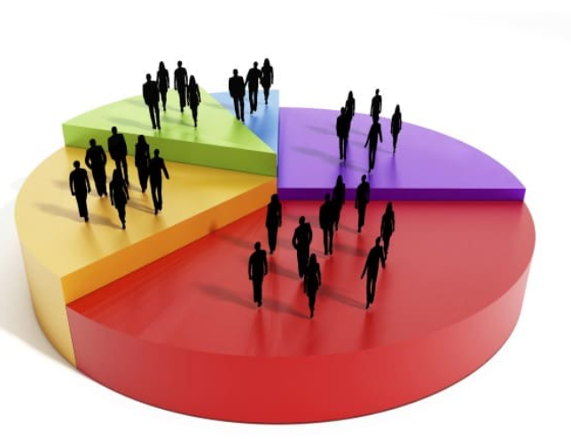
Customer Segmentation Analysis
1.What is a customer segmentation
Most banks have a large customer base - with different characteristics in terms of age, income, values, lifestyle, and more. Customer segmentation is the process of dividing a customer dataset into specific groups based on shared traits.
2.Customer segmentation purpose
Customer segmentation is a crucial business strategy that categorizes an organization's customers into distinct groups based on shared characteristics. By analyzing customer behavior and interactions with the company's services, businesses aim to identify patterns and preferences within each group. It enables them to tailor their services, develop more effective marketing strategies, and provide personalized experiences to meet the unique needs of each customer segment.
3.How to make customer segmentation: customer segmentation Outline
There are four primary types of customer segmentation:
1.Geographical: Based on customers' locations and regions.
2.Demographical: Segmentation by age, gender, and income of customers.
3.Behavioural: Categorizing customers according to their purchasing occasions, loyalty, and satisfaction levels.
4.Psychological: Segmentation according to customers' lifestyle, beliefs, and social status.

Slide 4
Project Contents​
MACHINE LEARNING PROCESS FLOW
MLPF contains 6 steps for completion or addresess conclusion.
1.IMPORTING LIBRARY
2.LOADING THE DATA
3.EXPLORATORY DATA ANALYSIS(EDA)
4.TRAIN-TEST SPLIT
5.BUILDING THE MODEL
6.TUNNING PROCESS CONCLUSION

Slide 5
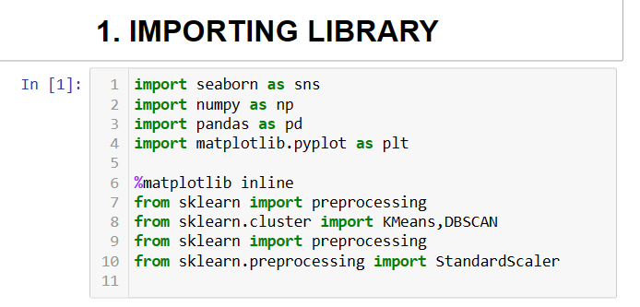

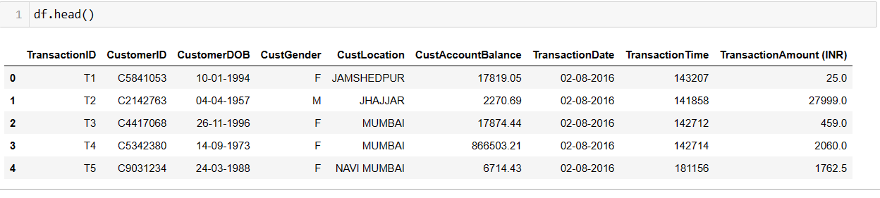
Importing Libraries, Loading and understanding the data
We will be using the following libraries
1.Pandas
2.Numpy
3.Seaborn
4.Matplotlib.pyplot
Now will be loading the data using pandas read_csv

Slide 6
Overview of Project
In the era of abundant data, machine learning has emerged as an invaluable tool for uncovering patterns and insights within customer data. Given the continuous and streaming nature of data, employing ML methods allows for the re-training of models with new data, enabling daily decision-making based on up-to-date information. ML efficiently analyzes data, providing a deeper understanding of customer behavior.
Among various ML algorithms, Hidden Markov Model (HMM) and different clustering algorithms are particularly well-regarded choices for addressing customer segmentation challenges.
In this exercise, my primary focus will be on K-Means clustering. K-Means is a heuristic algorithm used for clustering data based on a measure of closeness. It groups data into K clusters, where K represents the number of desired clusters. The algorithm works iteratively by moving the centroids (cluster centers) to the mean position of their constituent points and reassigning data instances to their closest clusters. This process continues iteratively until no significant change in the cluster centers is possible, leading to the convergence of the algorithm.

Slide 7

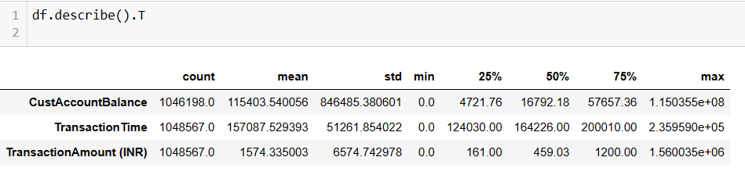

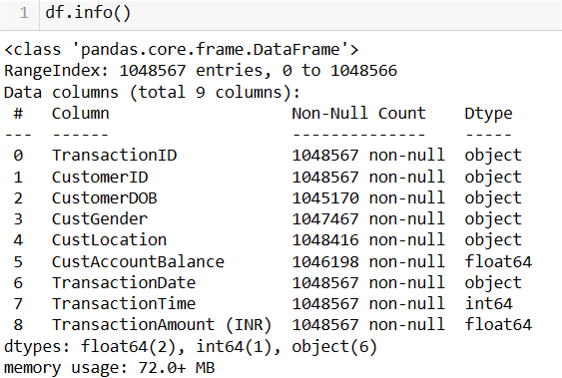
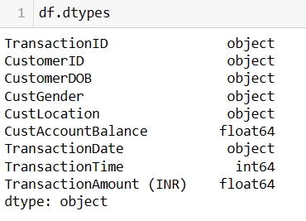
Shape & head():- with the help of shape attribute
we can get to know overall rows and columns in the
data and through head we can retrieve first 5 rows
of the dataset.
Describe:- the describe method returns the
description of the data.
Dtypes:- through datatypes we can infer that
there are one formats of Data types is int and object
info () :-the info function gets entire all information of data set

Slide 8
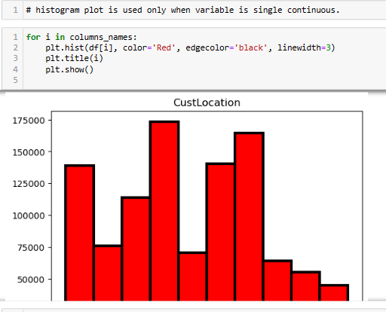
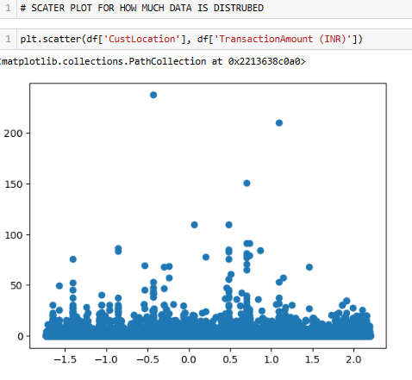
Distribution Analysis

Slide 9
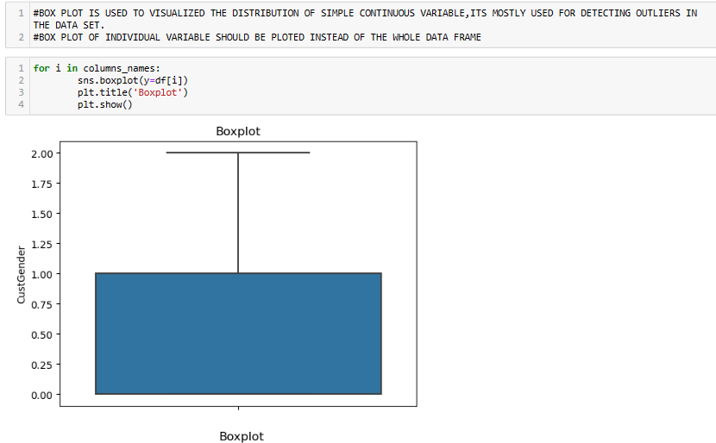
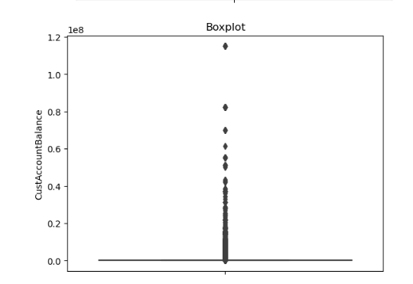
Distribution Analysis

Slide 10
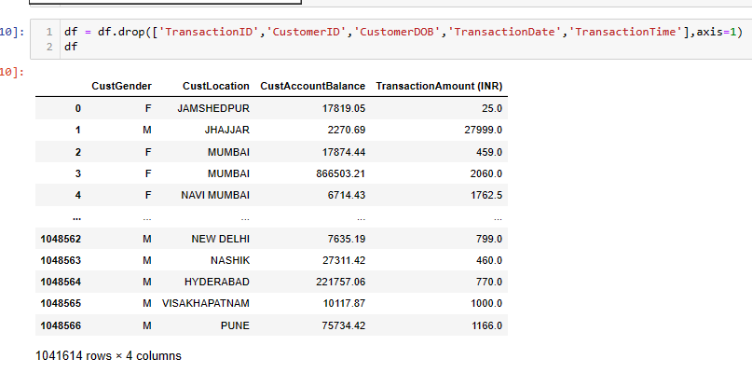
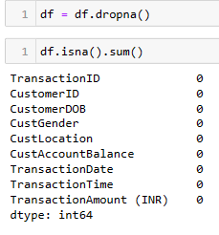
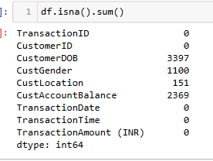
Missing value
df.isnull().sum() will understand the missing values
df.dropna() Understand drop value and columns

Slide 11
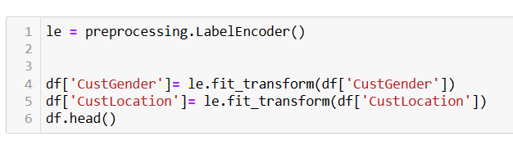
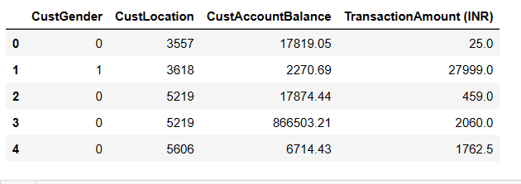
Feature Extraction
Convert the text data into numerical representations that can be used by machine learning models. Common techniques include Label encoder processor converts all categorical variables into numeric variables where machine can learn in own language.

Slide 12
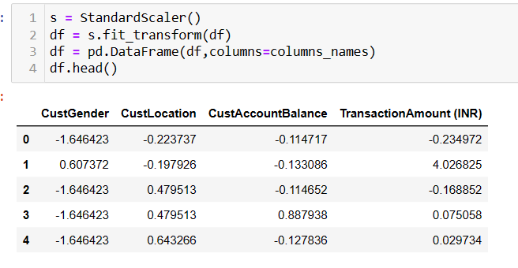
STANDERED SCALER USES FOR CONVERT ALL NUMERIC VALUES IN A PARTICULAR RANGE LIKE +3 TO -3 ,-9 TO +9 ,IF DATA IS HIGHLY SPREADED THEN +12 TO -12 FOR CONVERTING VALUES IN THIS RANGES WHERE ALL VALUES CAN NOT DOMINANT.

Slide 13
4. TRAIN-TEST SPLIT
IN UN SUPERWISED ALGORYTHEM HAVE UNLABLED DATA THAT MEANS X(INDEPENDENT VARIABLES),Y (DEPENDENT VARIABLE ) IS NOT GIVEN .
#ITS MOSTLY USE FOR CUSTOMER SEGMENTATION .
Now its time to remove all useless columns from the data set by using drop function and now I have a a snippet of the resulting data. This is a great step towards preprocessing text data for sentiment analysis.
If ready to move forward with training data analysis model using the preprocessed text data, can continue with the same techniques we discussed earlier. For instance, can use the preprocessed ‘CustAccountBalance ' column as the input features (X) and the ‘TransactionAmount (INR)' column as the target labels
Before proceeding, make sure to perform additional preprocessing steps such as converting text to lowercase, removing stop words, and potentially stemming or lemmatizing the words. These additional preprocessing steps can further enhance the quality of text data for modeling.

Slide 14
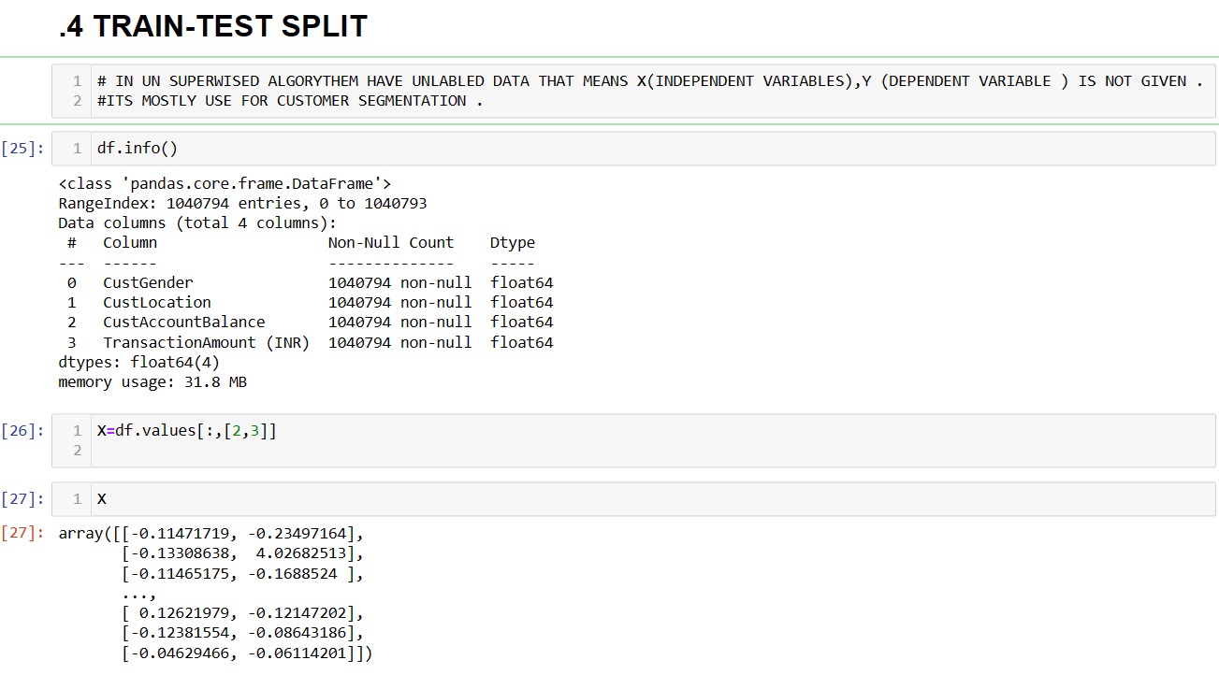

Slide 15
5.BUILDING THE MODEL
Model Selection: Choose an appropriate machine learning algorithm for sentiment analysis. Some popular choices include K-Means clustering or centroid –based clustering ,Support Vector Machines (SVM), Naive Bayes, Random Forest, and deep learning models like Recurrent Neural Networks (RNNs) or Transformer-based models.
K-MEANS CLUSTERING OR Centroid-based clustering
K-Means algorithm
1.Select the number of clusters
2.K Initialize the K centroids
3.Assign each data point to their closest centroid 4.For each cluster calculate the average of its assigned examples and let it the new position for that centroid
4.Reassign each data example to the new closest centroid of each cluster
5.Update the centroid position The model is ready

Slide 16
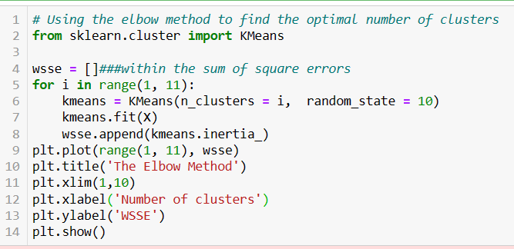
Model Building

Slide 17
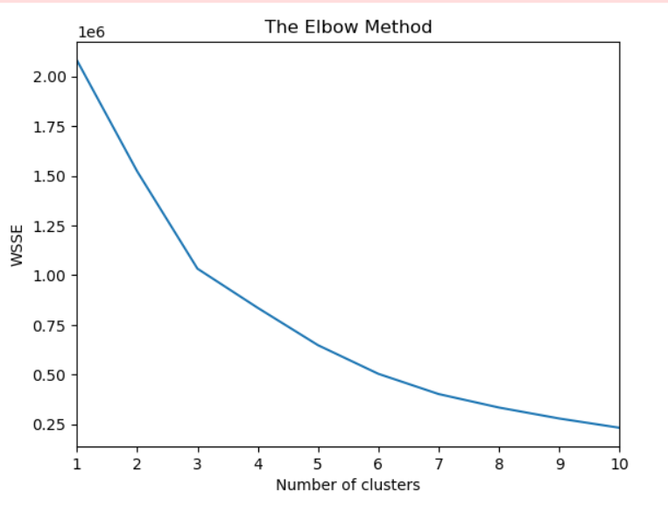
THE ELBOW METHOD
Use of elbow method for customer segmentation in which k- define number of clusters ,if k is given then we directly use the value of k otherwise we find value of ‘k’ using elbow method.
“k” is calculated by sum of square error of every centroid distance from every data point .in elbow method its randomly forms k clusters in the data set and takes k centroid of that k clusters once it is done on the basis of various distance matrix( Euclidian ,Man Hanton Kow skihamming) the data points are assigned to the nearest cluster.
Now again the centroid of the cluster is recomputed such that every cluster has a new centroid point.
Again the data points calculate the distance from the centroids and moves to the nearest cluster ,this process will be iterated n number of types until and unless its have 0 convergence.
Elbow method gives us the optimum value of K ,This value from the graph on which we have error points on ‘Y’ axis and numbers of ‘K’ on ‘X’ axis (1 to 10) ,the Elbow point generated from the graph is taken as the optimum value of ‘k’ .

Slide 18
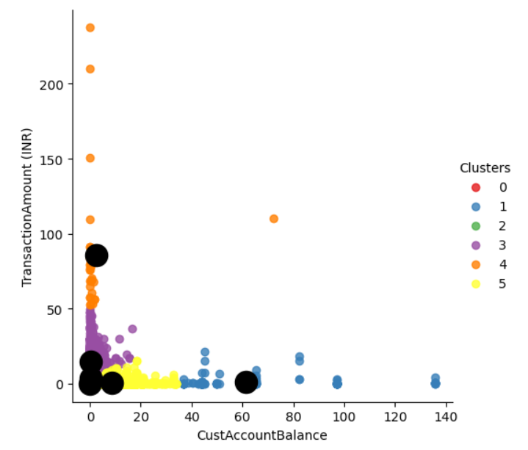
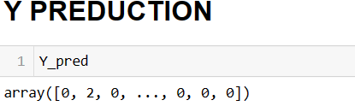
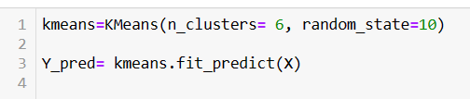
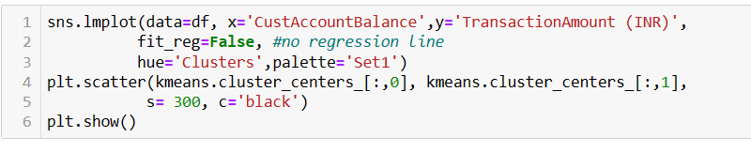
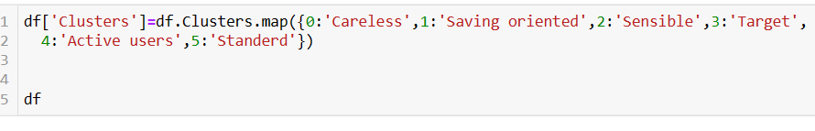
Graph between ‘custAccountBalance’ at ‘x’ axis and ‘TransactionAmount (INR)’ at ‘Y’
axis

Slide 19
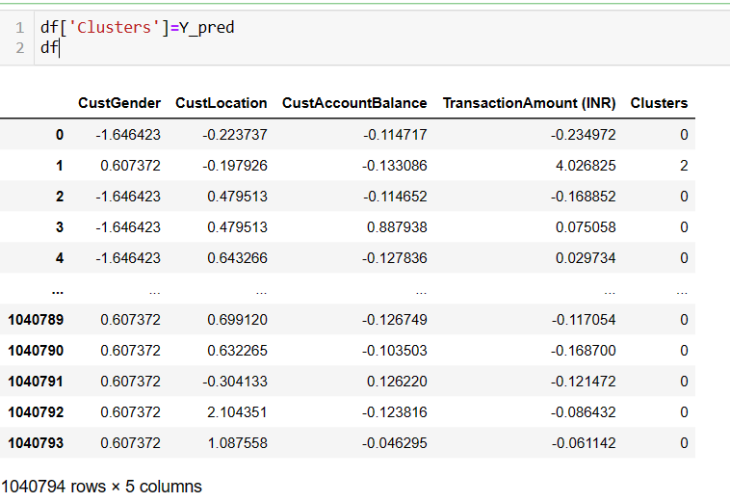
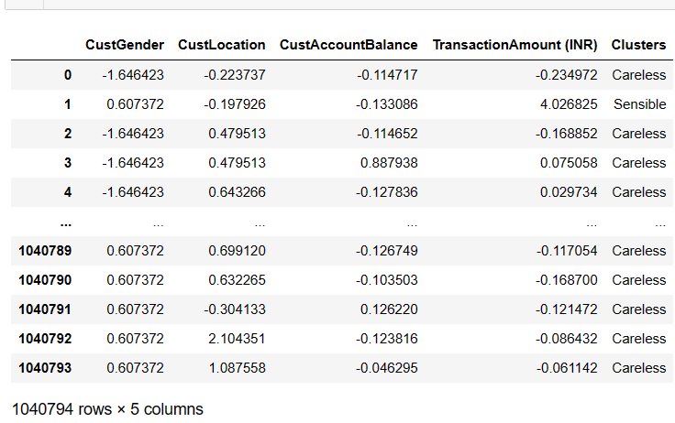
←------- In this Y pred will convert into clusters
-------→ Here all clusters have identification by different different clusters names

Slide 20
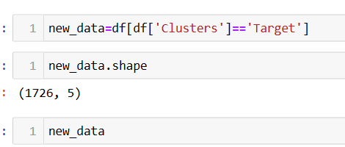
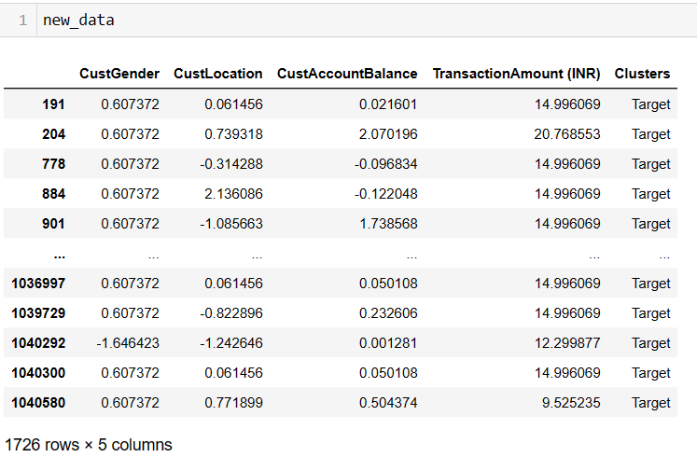
IN new data frame ,we will segregate all Target value through putting ‘Target’ in a conditional form with Clusters.
So now only those value will be visible which are conditionally applied like ‘Target’ customers ,here target value is (1726 ) .

Slide 21
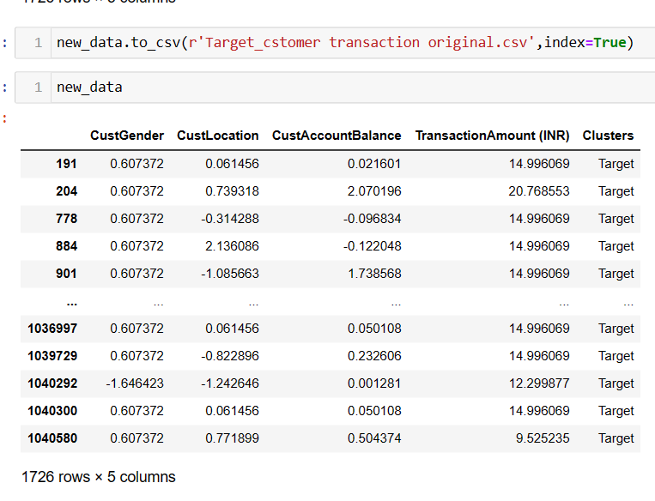
Extract all ‘Target’ from the data set and conversion into new data ‘csv’ format file by using above function and now all TARGET CUSTOMERS are separated in new csv file

Slide 22
6. CONCLUSION
1
​
From the sample of the dataset, we can divide the customers into two main groups.
#The cluster 3 ( Target)
Represents the customers being around young youth. They spend amount in a moderate form of transaction and they are quality customers for bank products and also they spend a lot time in application and possess little amount in their account after the active transaction.
#The cluster 1 ( Saving oriented)
represents the customers being around aged person. They spend very less amount in per t transaction and spend very few time in application. They possess large amount in a saving form in their account. They are saving loving person so do not uses application for transaction frequently.
In other words, customers in cluster 4 (Active users)
represents the customers being around very young youth generation. They spend excessive time over the application and huge amount in per transaction and They possess very vary little amount in a saving form in their account. They are careless person so they uses application for frequently.

Slide 23
Thank you!!!

